Slide 1
Introduction to Data Independent Acquisition
Jarrett Egertson, Ph.D.
Staff Scientist / Consultant
MacCoss Lab

Slide 2
Part 1: How Does DIA Work?

Slide 3
Comprehensive MS/MS Acquisition
20 20 m/z-wide windows = 400 m/z
500
m/z
900
Notes:
Switch to 20, put in some MS1 scans
Usually 1,000 – 5,000 peptides identified by MS/MS
Usually ~25,000 – 50,000 MS features detected
2-20% of Features Annotated
BUT Usually only ~70% overlap in annotated features between runs

Slide 4
Comprehensive MS/MS Acquisition
20 20 m/z-wide windows = 400 m/z
500
m/z
900
Scan 1
Notes:
Switch to 20, put in some MS1 scans
Usually 1,000 – 5,000 peptides identified by MS/MS
Usually ~25,000 – 50,000 MS features detected
2-20% of Features Annotated
BUT Usually only ~70% overlap in annotated features between runs

Slide 5
Comprehensive MS/MS Acquisition
20 20 m/z-wide windows = 400 m/z
500
m/z
900
Scan 1
Scan 2
Notes:
Switch to 20, put in some MS1 scans
Usually 1,000 – 5,000 peptides identified by MS/MS
Usually ~25,000 – 50,000 MS features detected
2-20% of Features Annotated
BUT Usually only ~70% overlap in annotated features between runs

Slide 6
Comprehensive MS/MS Acquisition
20 20 m/z-wide windows = 400 m/z
500
m/z
900
Scan 1
Scan 2
Scan 3
Scan 4
Scan 5
Scan 6
Scan 7
…
Scan 20
Scan 21
Notes:
Switch to 20, put in some MS1 scans
Usually 1,000 – 5,000 peptides identified by MS/MS
Usually ~25,000 – 50,000 MS features detected
2-20% of Features Annotated
BUT Usually only ~70% overlap in annotated features between runs

Slide 7
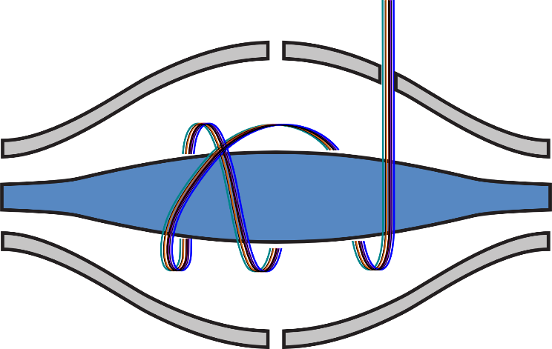
Comprehensive MS/MS Acquisition
20 20 m/z-wide windows = 400 m/z
500
m/z
900
~2 seconds
Precursor Filter
780-800 m/z
Orbitrap Mass Analyzer
Time
Notes:
Add in MS1 scans here

Slide 8
Comprehensive MS/MS Acquisition
20 20 m/z-wide windows = 400 m/z
500
m/z
900
MS Scan
~2 seconds (Q-Exactive)
Time
Notes:
Add in MS1 scans here

Slide 9
Why????

Slide 10
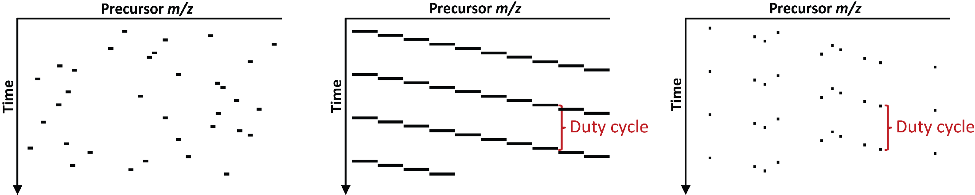
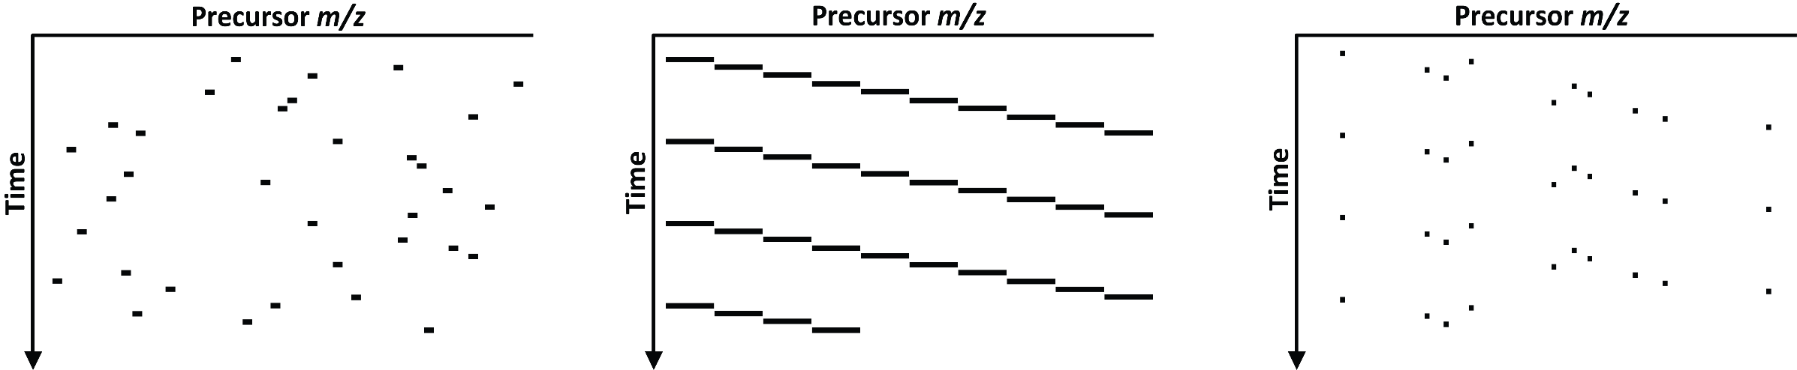
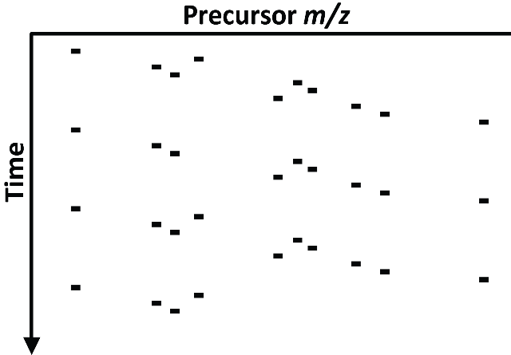
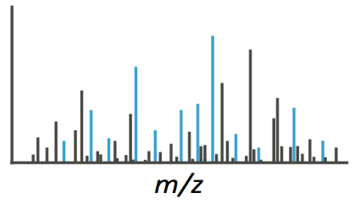
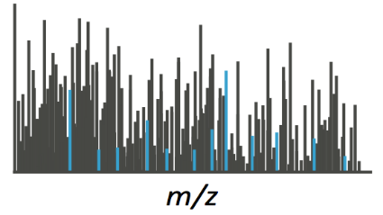
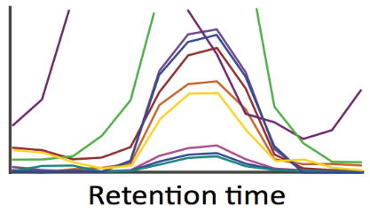
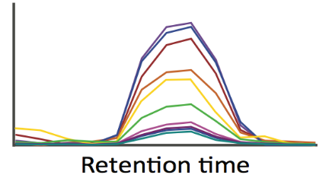
DIA Combines the Merits of DDA and Targeted Acquisition
at cost of precursor selectivity
Data Dependent Acquisition (DDA)
Data Independent Acquisition (DIA)
Parallel Reaction Monitoring (PRM)
Cycle time
Cycle time
NLPFSVENK
NLPFSVENK
NLPFSVENK
NLPFSVENK
Database Searching
Targeted Analysis
Peptide Identification
Peptide Quantification
Ying Sonia Ting

Slide 11
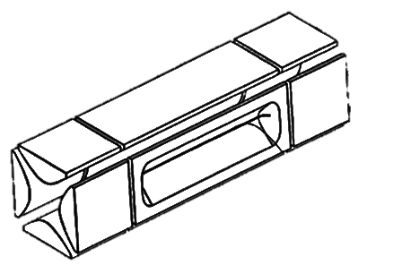
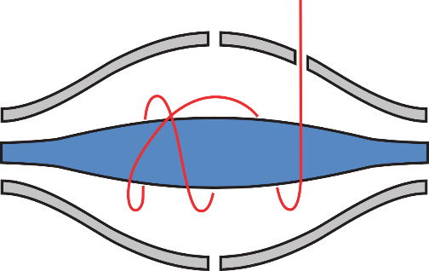
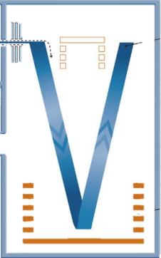
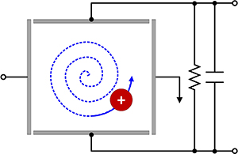
Data Independent Acquisition
“All” Reaction Monitoring (coined by Bruce Lab)
20 20 m/z-wide windows = 400 m/z
500
m/z
900
Measure all fragment ions for all precursors between 500 and 900 m/z
Orbitrap
Linear Ion Trap
TOF
FT-ICR

Slide 12


DIA Data Acquisition
Comprehensive MS1 and MS2 Sampling
500
m/z
900
Consistent Sampling
Chromatographic Time Scale
2
sec
Un-Targeted
Time
Un-Biased
500
m/z
520
m/z
20 m/z
Wide Isolation
Notes:
Fix the Un-Targeted part, make it show the center of the scan, and then indicate how the peak is offset, and then have the peak jump around

Slide 13
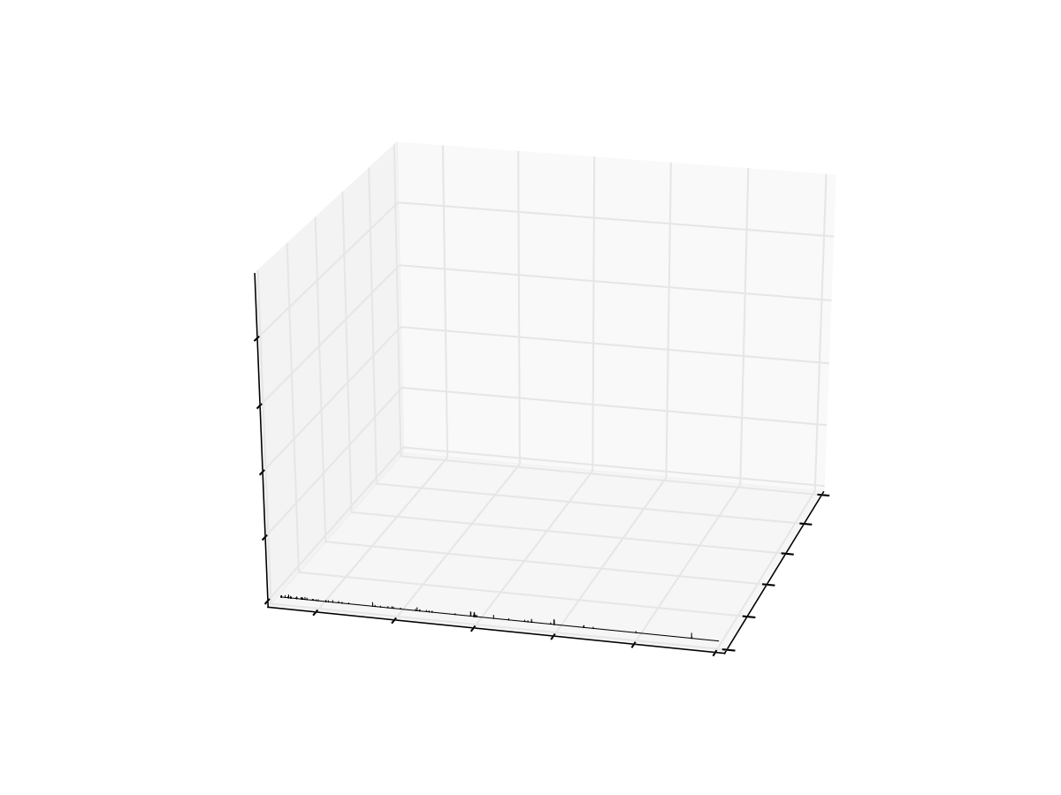
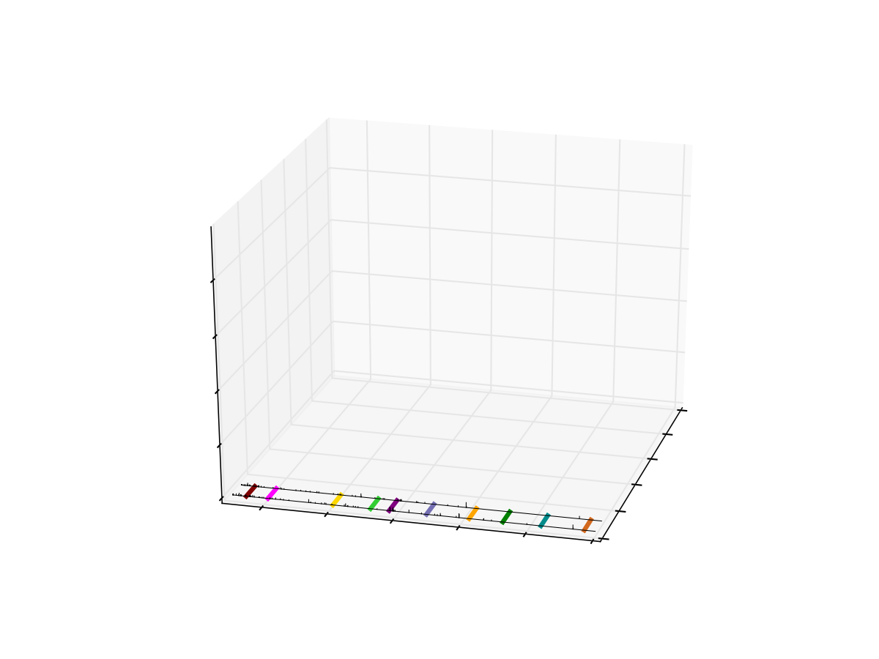
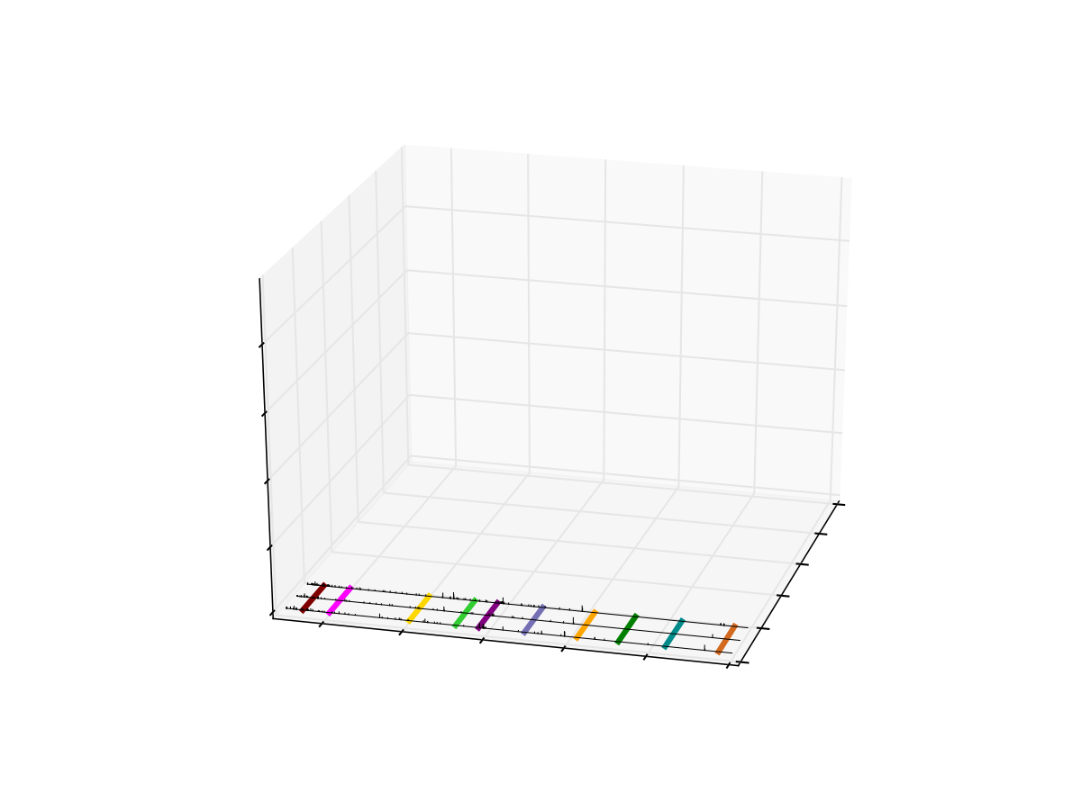
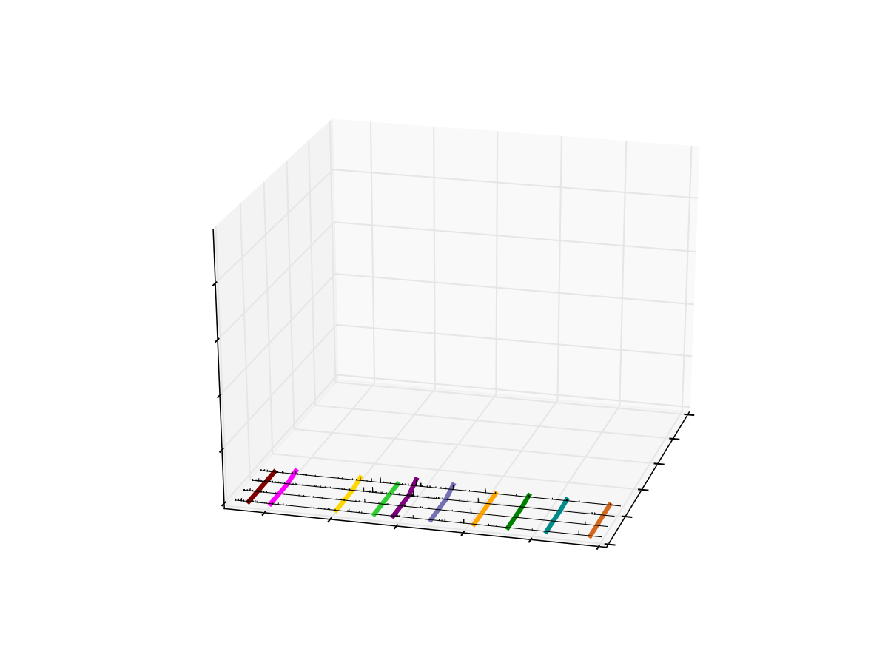
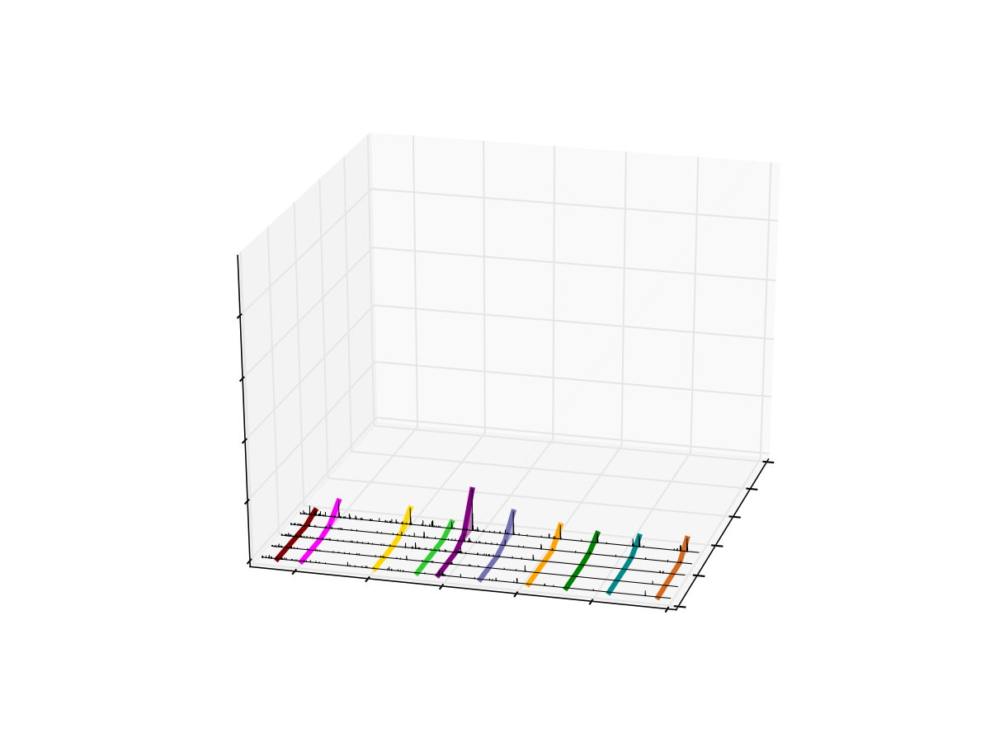
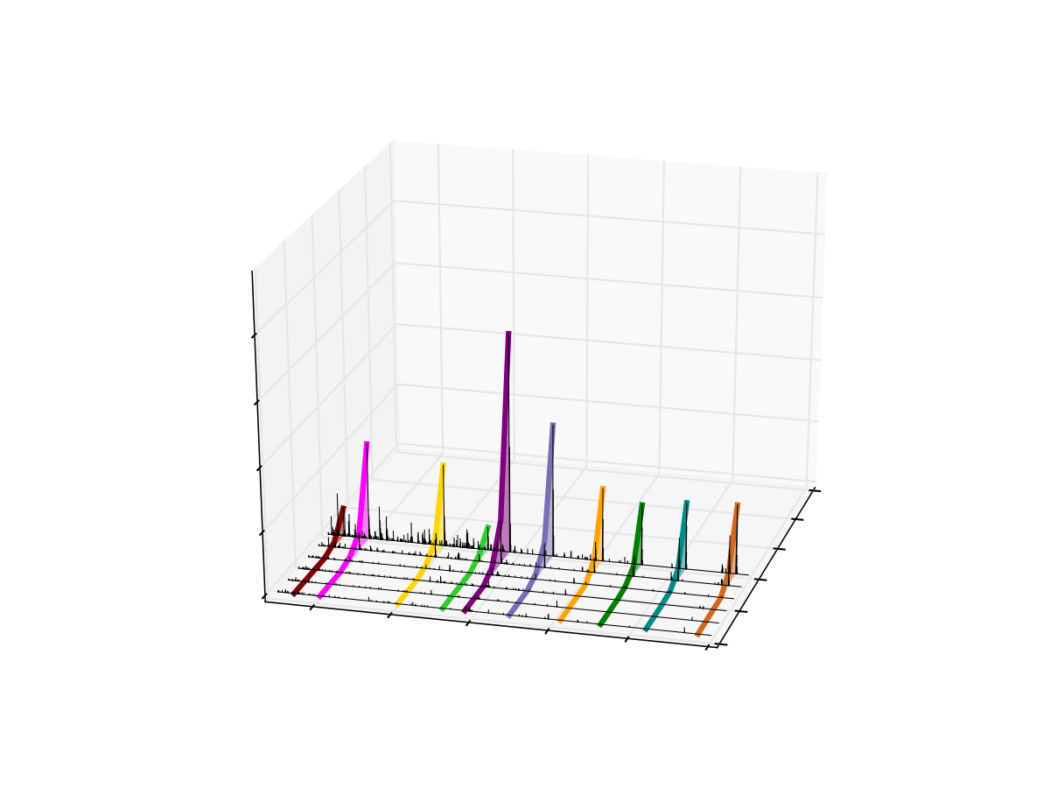
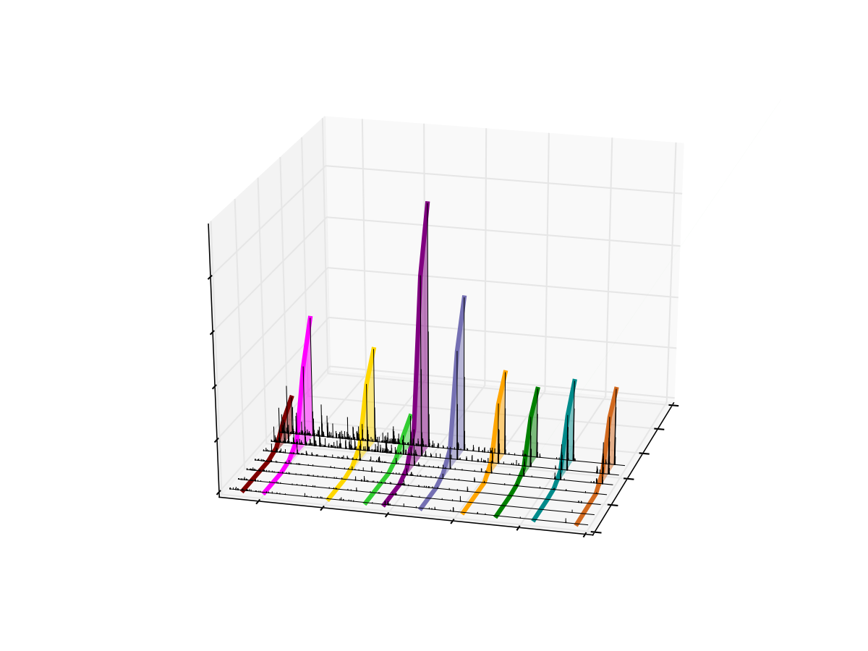
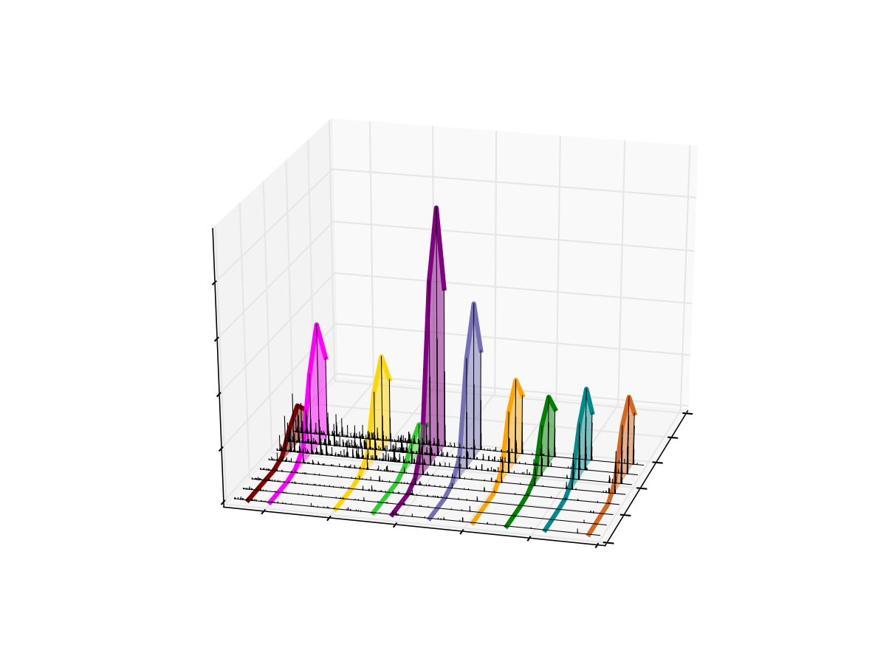
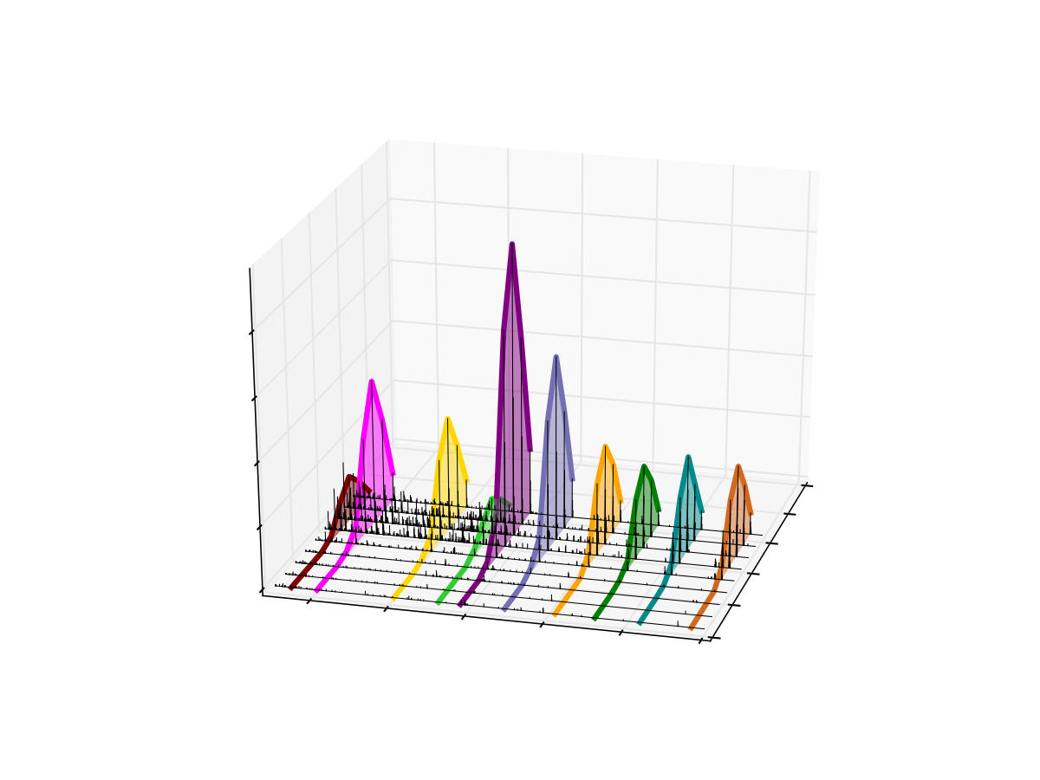
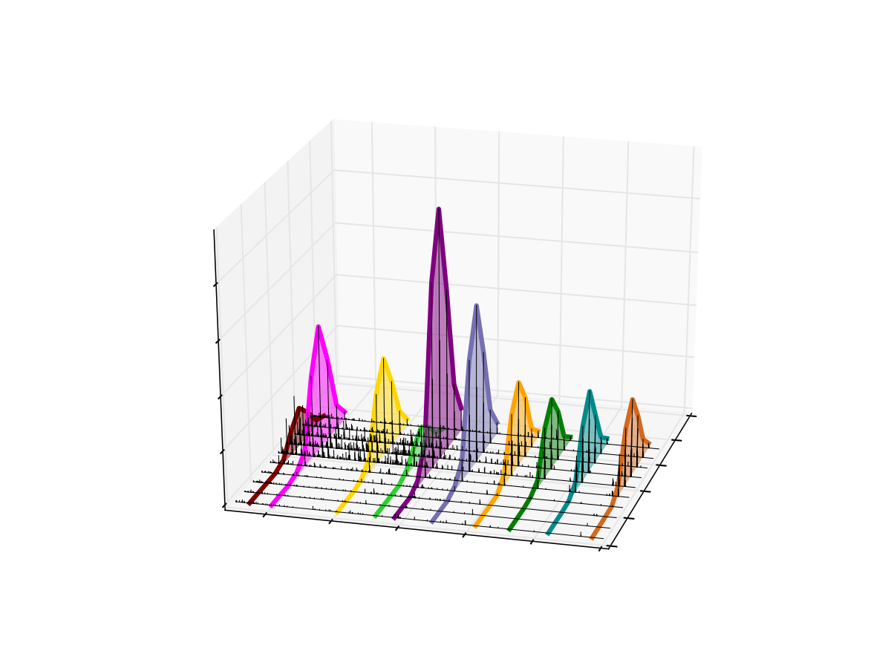
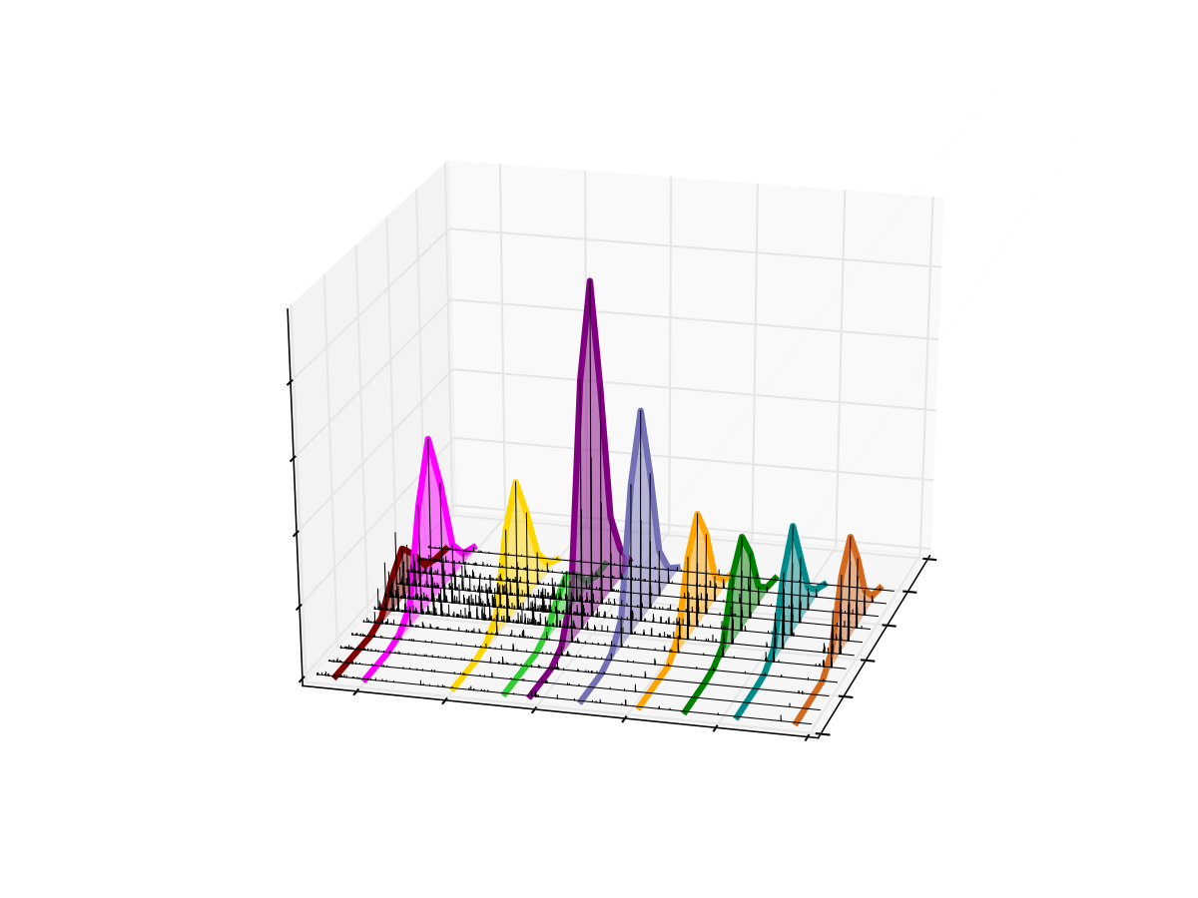

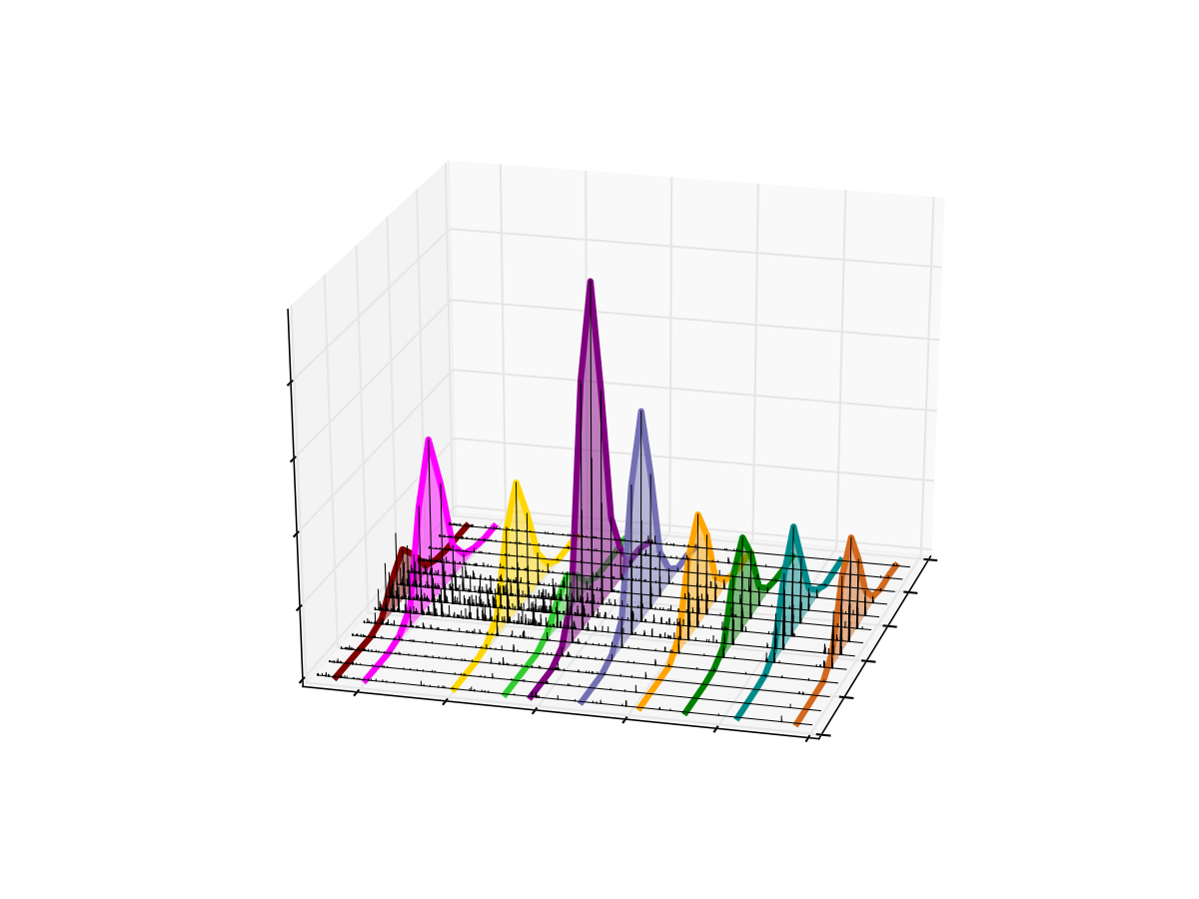
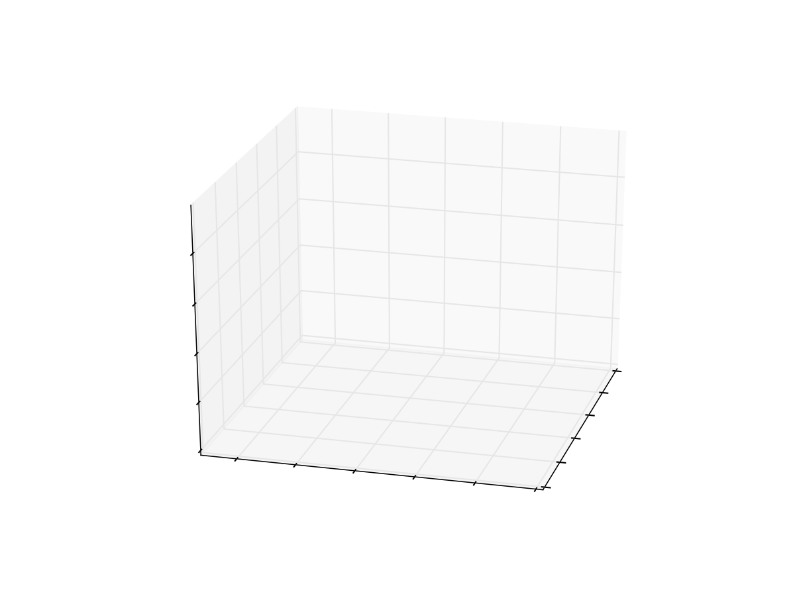
Targeted Chromatogram Extraction for VLENTEIGSDSIFDK++ (790.4 m/z)
500
m/z
900
4
3
Intensity x 10⁻⁵
780m/z
800
m/z
2
51.7
51.6
1
51.5
51.4
0
Retention Time
400
51.3
600
800
1000
51.2
1200
1400
m/z
Notes:
Show query peptide here,

Slide 14
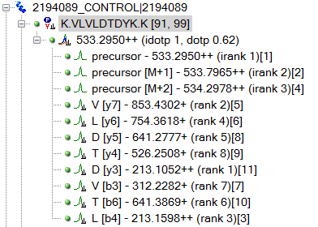
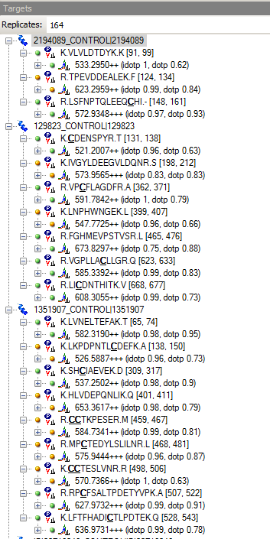
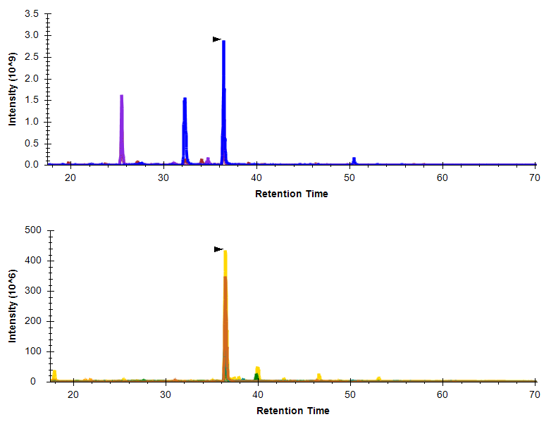
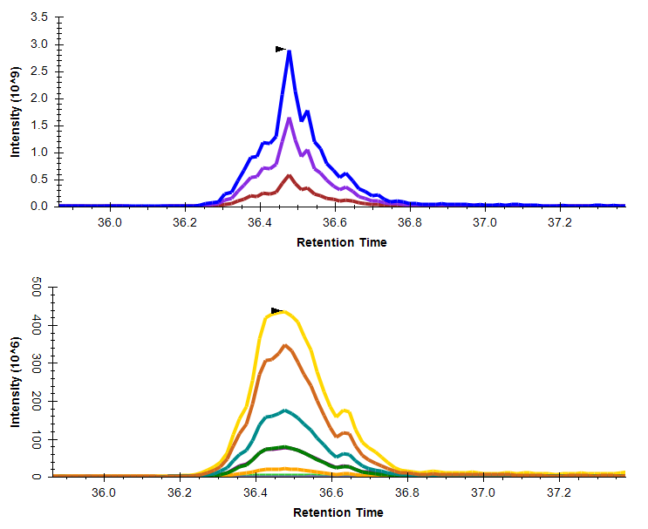
DIA Data Analysis
Set Peak Boundaries
Extract Chromatograms
Select Chromatographic Peak
Select Target Peptides
MS1
MS2

Slide 15
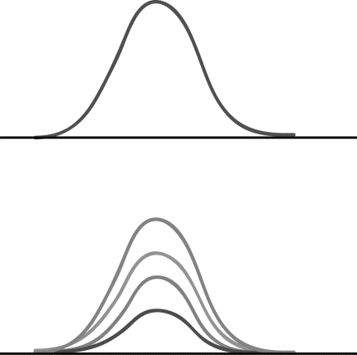
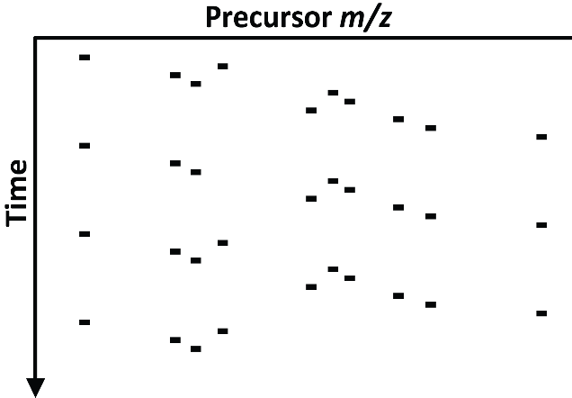
“SRM” on “All”
DIA
PRM/SRM

Slide 16

DIA – A “complete” dataset
Query for any peptide/protein
SNPs
PTMS
Protein isoforms
Notes:
Make the grey bars darker

Slide 17
Is it Really SRM/PRM on All?
What are the drawbacks?
Notes:
-- lack of charge state optimization
-- wide isolation windows causes myriad problems
-- you still have to choose a m/z range to target
-- cost
-- sensitivity
-- data acquisition downstream

Slide 18
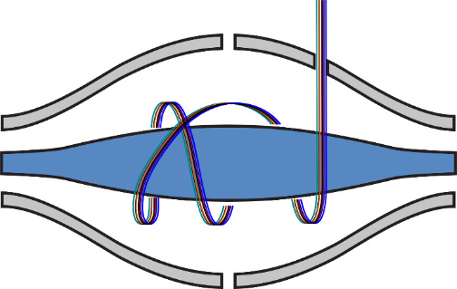
DIA
Targeted Extraction
Un-Targeted
Wide
Full Scan
HR/AM
Isolation
20 m/z Isolation Window
Mass Analysis
Targeted Acquisition
Targeted
Narrow
Mass Filter
Low Resolution
0.7 m/z Isolation Window
SRM

Slide 19
The Advantages of DIA

Slide 20
DIA
SRM
Data Acquisition
Hypothesis Generation
Hypothesis Generation
Peptide Selection
RT Scheduling
Peptide Selection
Transition Selection or Refinement
Chromatogram Extraction
Peak Integration
Data Acquisition
Transition Refinement
Peak Integration
Hypothesis Test
Hypothesis Test

Slide 21
DIA
SRM
Data Acquisition
Hypothesis Generation
Hypothesis Generation
Peptide Selection
RT Scheduling
Peptide Selection
Transition Selection or Refinement
Chromatogram Extraction
Peak Integration
Data Acquisition
Transition Refinement
Peak Integration
Hypothesis Test
Hypothesis Test

Slide 22
DIA
SRM
Data Acquisition
Hypothesis Generation
Hypothesis Generation
Peptide Selection
RT Scheduling
Peptide Selection
Transition Selection or Refinement
Chromatogram Extraction
Peak Integration
Data Acquisition
Transition Refinement
Peak Integration
Hypothesis Test
Hypothesis Test

Slide 23
DIA
SRM
Data Acquisition
Hypothesis Generation
Hypothesis Generation
Peptide Selection
RT Scheduling
Peptide Selection
Transition Selection or Refinement
Chromatogram Extraction
Peak Integration
Data Acquisition
Transition Refinement
Peak Integration
Hypothesis Test
Hypothesis Test

Slide 24
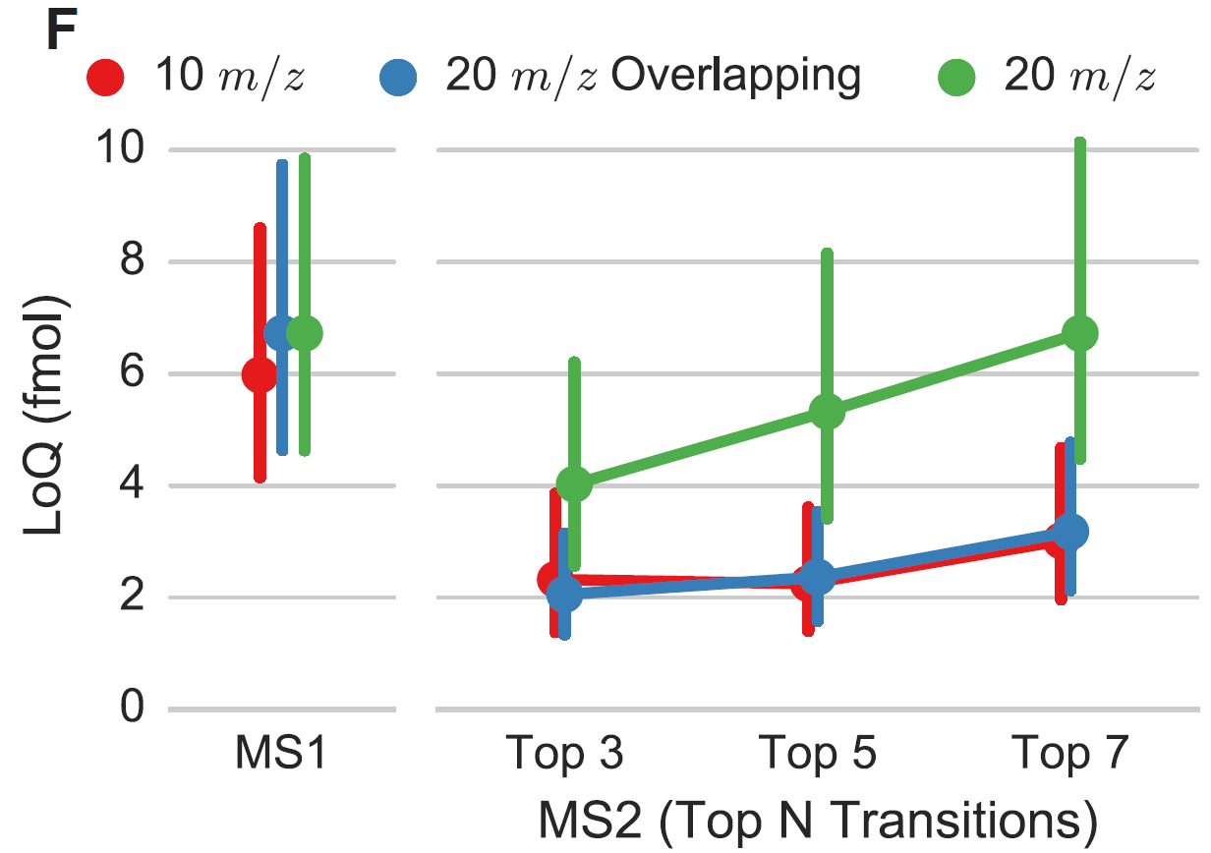
MS/MS Quantification is More Sensitive than MS
~30 bovine peptides spiked into a yeast background (Q-Exactive)

Slide 25
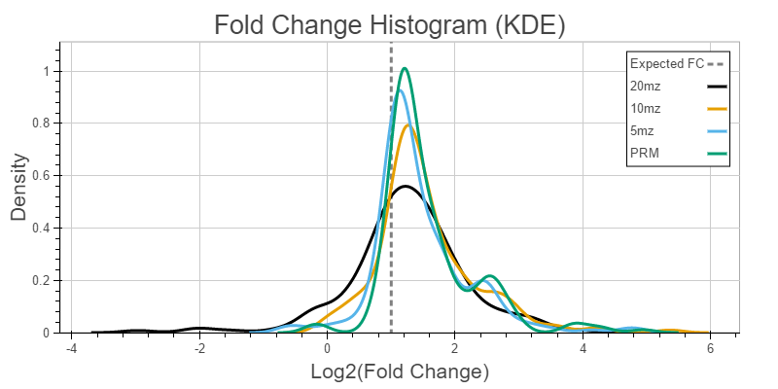
150 peptides spiked in at 1 and 2 fmol (human neuronal cell background)

Slide 26
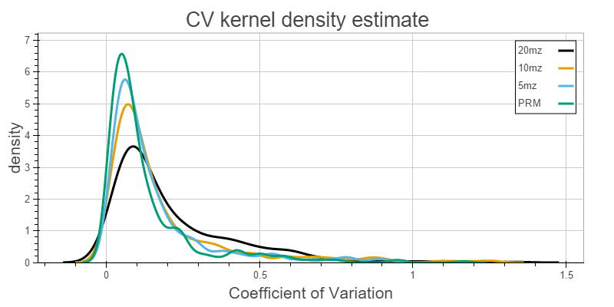
150 peptides spiked in at 1 and 2 fmol (human neuronal cell background)

Slide 27
Peptide Detection from DIA Data
How do you go about detecting peptides in DIA data?
Can you use a database search?
Different from SRM?
Are peptides being detected or identified?
Notes:
Can a database searching approach work?

Slide 28
Peak Picking is Challenging
Peptide: NLPFSVENK ++

Slide 29
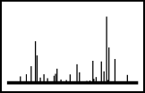
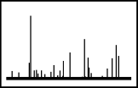
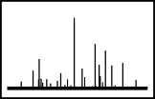
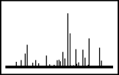
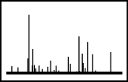
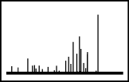
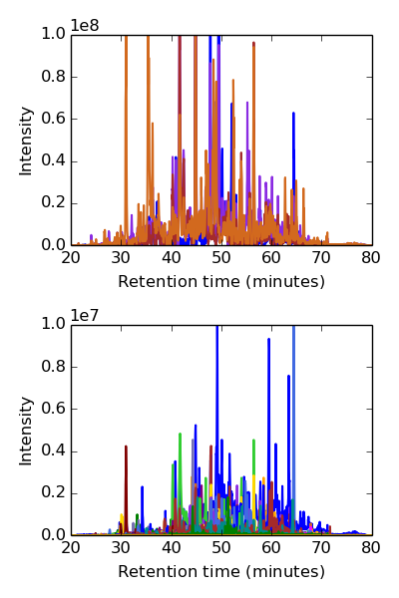
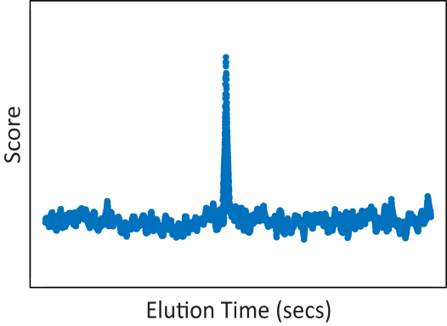

Detecting Peptides from DIA Data Directly
Spectrum-centric analysis
What peptides best explain the data?
p-value
q-value
Protein sequence DB
MS/MS spectra
p values are returned for every queried peptide
Peptide spectrum matches
(PSMs)
example tools:
SEQUEST, MASCOT … etc.
Peptide-centric analysis
Which peptides are detected in our data?
Peptides of interest
p-value
q-value
APTNVTCILK
example tools:
OpenSWATH, Skyline
Extracted MS/MS data
Evidence for detection
Slide by Sonia Ting
Notes:
Instead of searching spectrum over a protein sequence database, as we usually do, we search targeted peptides over our data, trying to find whether this peptide was detected by our data (spectra collected).
Most database search algorithms assume one peptide per MS2 spectrum. This is how they are built.
Look at peptide identification problem in different light!
"We have a set of spectra and we would like to know what peptides that generated them".
"Which of these peptides do we have some kind of spectral evidence for?"

Slide 30
Tools for Detecting Peptides in DIA Data are Becoming More Prevalent
 | No Spectral Library | Spectral Library
Peptide Centric | FT-ARM PECAN | OpenSWATH PeakView EncyclopeDIA Spectronaut
Spectrum Centric | DIA-UMPIRE Group-DIA MS^{E} MSPLIT-DIA

Slide 31


PECAN First Analyzes each Isolation Window Independently
Peptides of interest
PECAN
Analyze isolation window: 870-880 m/z
870-880 m/z
DIA
Target peptides
VTSAYLQDIENAYKK
Decoy peptides
870-880 m/z
KYANEIDQLYASTVK
Ying Sonia Ting

Slide 32

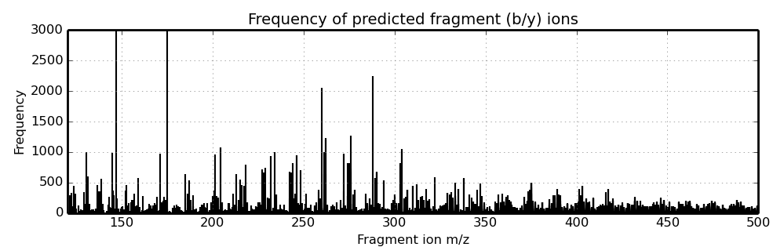
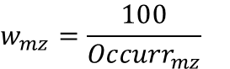
PECAN Step 1: Peptide Scoring
Peptides of interest
PECAN
Protein sequence DB
1a. Calculate fragment ions specificity
870-880 m/z
Distribution of predicted fragment (b-/y-) ions
K[y1]: 147.1128
Frequency of occurrence
R[y1]: 175.1190
Fragment ion m/z
Ying Sonia Ting

Slide 33
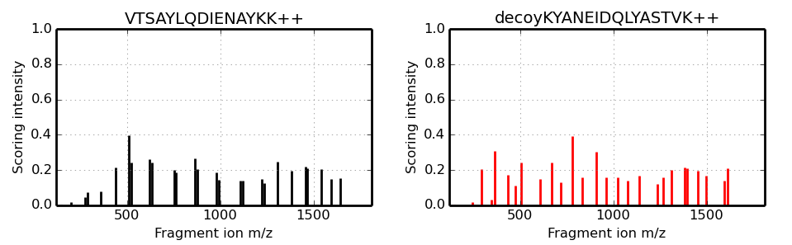
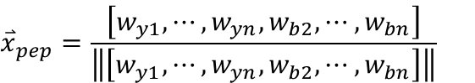
PECAN Step 1: Peptide Scoring
Peptides of interest
PECAN
Protein sequence DB
1b. Generate scoring vector for peptides
PECAN generated scoring vector
Target
Decoy
( for all b-/y- ions )
Ying Sonia Ting

Slide 34
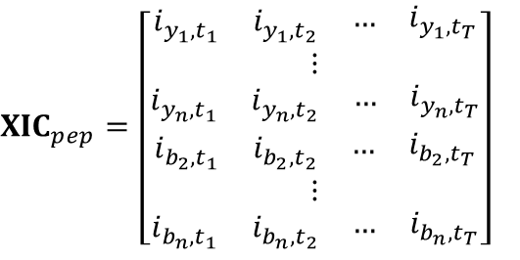
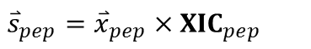
PECAN Step 1: Peptide Scoring
Peptides of interest
PECAN
1c. Score with fragment ion XICs
DIA
Centroid .mzML
Target
time
transition
Ying Sonia Ting

Slide 35
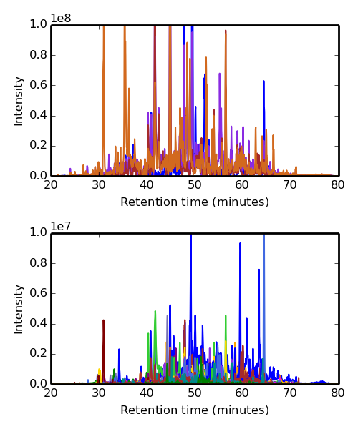



PECAN Step 1: Peptide Scoring
Peptides of interest
PECAN
1c. Score with fragment ion XICs
DIA
Centroid .mzML
Target
Target
Decoy
Decoy

Slide 36






PECAN Step 2: Background Subtraction
PECAN
Protein sequence DB
2a. Estimate background score
870-880 m/z
Thousands of randomly shuffled peptides
Scoring vectors
Ying Sonia Ting

Slide 37

PECAN Step 2: Background Subtraction
Peptides of interest
PECAN
2b. Subtract background score
Target
Target
Target
Decoy
Decoy
Decoy
Ying Sonia Ting

Slide 38




PECAN Step 3: Peak Picking
Peptides of interest
PECAN
3a. Pick the top N peaks (N=1)
3
1
2
4
5
6
Ying Sonia Ting

Slide 39

PECAN Step 3: Peak Picking
Peptides of interest
PECAN
3b. Generate auxiliary scores for a peak
Fragment ions
- raw score
- background subtracted score
- spectrum similarity
- number of contributing ions
- mass error mean
- mass error variance
- rank
Precursor ions
- idotp (isotope dot product)
- mass error mean
- mass error variance
Peptide sequence
- charge state
- peptide length
- SSR hydrophobicity index
Ying Sonia Ting

Slide 40


PECAN Step 4: Statistical analysis
Peptides of interest
PECAN
4. Statistical analysis
400-410m/z
410-420m/z
420-430m/z
880-890m/z
890-900m/z
Peptides of interest
APTNVTCILK
Percolator
p-value
q-value
Decoy peptides
CVITNLAPTK
Percolator, Käll et al. 2007

Slide 41
Peptide Detection Sensitivity Scales with Isolation Width
4 second cycle time
Pierce HeLa digest
Fusion Lumos
500 – 700 m/z
4 second
cycle time
2 second cycle time
2 second cycle time

Slide 42
Isolation Window Width
DDA
DIA
Vs.
Vs.
2 m/z
10 m/z
20 m/z
Lower precursor selectivity
More peptides co-fragmented
More complex MS/MS spectra
More interference
Notes:
Show the spectrum, and the chromatogram
Even with DDA >30% of the spectra are mixed
Quantitation can be limited by interference, show 10 m/z vs. 20 m/z (from overlap experiment)
Spectrum and chromatogram from loq data on a yeast background peptide

Slide 43

Precursor Selectivity
2 m/z
ANFQGAITNR
Notes:
Show the spectrum, and the chromatogram
Even with DDA >30% of the spectra are mixed
Quantitation can be limited by interference, show 10 m/z vs. 20 m/z (from overlap experiment)
Spectrum and chromatogram from loq data on a yeast background peptide

Slide 44

Precursor Selectivity
10 m/z
ANFQGAITNR
Notes:
Show the spectrum, and the chromatogram
Even with DDA >30% of the spectra are mixed
Quantitation can be limited by interference, show 10 m/z vs. 20 m/z (from overlap experiment)
Spectrum and chromatogram from loq data on a yeast background peptide

Slide 45

Precursor Selectivity
20 m/z
ANFQGAITNR
Notes:
Show the spectrum, and the chromatogram
Even with DDA >30% of the spectra are mixed
Quantitation can be limited by interference, show 10 m/z vs. 20 m/z (from overlap experiment)
Spectrum and chromatogram from loq data on a yeast background peptide

Slide 46

Precursor Selectivity
4e7
Intensity
10 m/z
ANFQGAITNR
25
Retention Time (min)
26
Notes:
RT 25-26 intensity 40e6

Slide 47

Precursor Selectivity
✓
X
4e7
Intensity
10 m/z
ANFQGAITNR
✓
X
4e7
✓
X
20 m/z
Intensity
25
Retention Time (min)
26
Notes:
RT 25-26 intensity 40e6

Slide 48

m/z Range Covered
Notes:
EXTRA MATERIAL? – how this was calculated
by Jesse, also show numbers from Rapa study in overlap paper

Slide 49

Cycle Time
20 20 m/z-wide windows = 400 m/z
10 Hz
500
m/z
900
40 10 m/z-wide windows = 400 m/z
500
m/z
900
~7 scans
15 scans
Cycle Time: 4 seconds
Cycle Time: 2 seconds
~30 seconds
~30 seconds
Notes:
Add in MS1 scans here

Slide 50
Cycle Time
20 20 m/z-wide windows = 400 m/z
10 Hz
500
m/z
900
10 40 m/z-wide windows = 400 m/z
500
m/z
900
~6 seconds
Notes:
Add in MS1 scans here

Slide 51
Number of Injections
80 5 m/z-wide windows = 400 m/z
500
m/z
900
40 5 m/z-wide windows = 200 m/z
40 5 m/z-wide windows = 200 m/z
500
m/z
900
~30 seconds
~30 seconds
Notes:
What if I want to keep the better Cycle Time for quantification

Slide 52

Improving Precursor Selectivity
✓
X
✓
X
Notes:
Take a normal DIA scheme, with 20 m/z wide windows, overlap them (schematic figure)

Slide 53

20 m/z DIA
GVMNAVNNVNNVIAAAFVK

Slide 54

20 m/z DIA + Overlap
GVMNAVNNVNNVIAAAFVK

Slide 55

20 m/z DIA + Overlap + Demultiplexing
GVMNAVNNVNNVIAAAFVK

Slide 56
10 m/z DIA
GVMNAVNNVNNVIAAAFVK

Slide 57

The Promise of DIA
Acquire a “molecular image” or “digital archive” of the sample
Mine it over and over
No scheduling
Direct queries (and p-values) for peptides of interest
Better quantitation than DDA
Notes:
Acquire a molecular image
Go back to it whenever you want, requery
Better quantification when you do query

Slide 58



Image Quality

Slide 59




DDA vs. DIA vs. SRM
DDA
DIA
SRM/PRM
MS Quantification
MS/MS Quantification
High Selectivity MS/MS
Quantification
on semi-random subset
on almost everything
on targets
Notes:
As instruments scan faster, DDA turns into DIA

Slide 60
DIA for P100
Build a “super library” from a pooled sample
Map detections from library to all future single-shot DIA datasets

Slide 61








Chromatogram
Spectral Library Workflow
Build a Chromatogram Library
Build a Spectral Library
Acquire DIA Data
12 DIA Runs
2 m/z Isolation
Pooled Sample
Multiple
DDA Analyses
Pooled Sample
1 DIA Run
20 m/z Isolation
/per sample
Peptide
Detection
Database Search
Identification
Chromatogram Extraction
Quantification
Notes:
-- bad way to pick peptides
-- whole point of DIA is to be able to query for anything…

Slide 62
DIA Library Generation with 12 LC-MS/MS Runs
12 LC-MS/MS Runs
400 m/z
1000 m/z
Inj. 1
Inj. 2
…
…
…
Inj. 12
400 m/z
450 m/z
25 x 2 m/z
MS/MS Scans
30k R.P.
2.5 second
cycle time
Peptide Detection
Spectrum
Mill
MS1 30k R.P.
Notes:
Mention that 2 m/z isolation windows give great sensitivity for detection, getting close to PRM
Can extract chromatograms for any peptide, need a way of confirming its identity

Slide 63




12 LC-MS/MS Runs to Increase Sensitivity in All Future Runs
1 LC-MS/MS Run
22 m/z overlapping windows
Single sample
Chromatogram Library
10,571 phosphopeptides
12 LC-MS/MS Runs
2 m/z windows
Sample pool

Slide 64
12 LC-MS/MS Runs to Increase Sensitivity in All Future Runs
7,594 phosphopeptides
Chromatogram Library
10,571 phosphopeptides
EncyclopeDIA*
12 LC-MS/MS Runs
2 m/z windows
Sample pool
*Searle BC, et. al. In preparation

Slide 65



Transition Refinement by EncyclopeDIA
Raw Transition
Intensity
quant threshold
Retention Time (min)
Normalized Signal
Retention Time (min)
Picked Transition
Intensity
Retention Time (min)
Brian Searle

Slide 66

Peptide Detection in Multiple Runs
What’s happening here?
Notes:
Detection in different places between runs

Slide 67

Outlier Detection

Slide 68


Outlier Detection: RT Alignment
2
3
4
5
…
30
Runs to Align
Run to Align RT
1
Reference
Reference RT

Slide 69

Outlier Detection: Pairwise Deviation
1
2
3
4
…
30
2
3σ
3σ
…
3σ
Fit to inner
98%
3σ
…
3σ
# of Peptides
3
4
3σ
…
…
30
Retention Time Error (min)

Slide 70
Outlier Detection
For each peptide…
19
1
4
8
12
17
2
3
5
7
9
10
15
20
11
13
16
18
Aligned Retention Time
6
14
LC-MS/MS Run

Slide 71
Outlier Detection
For each peptide… sort by RT
19
4
8
17
1
12
3
10
5
2
7
20
15
9
16
13
11
18
Aligned Retention Time
6
14
3σ ?
LC-MS/MS Run

Slide 72


Outlier Detection
Before
After
Retention Time
Retention Time
Retention Time

Slide 73

Peak Boundary Imputation
100%: Detected
50%: Detected
1%: Imputed

Slide 74

Imputation by Non-Parametric Pairwise Alignment
Retention Time (Run 2)
Retention Time (Run 1)
Retention Time (Run 1)

Slide 75

P6000!!

Slide 77
Acknowledgements
MacCoss Lab
Mike MacCoss
Sonia Ting
Brian Searle
Austin Keller
Richard Johnson
Lindsay Pino
Brendan MacLean
Han-Yin Yang
Gennifer Merrihew
Broad Institute
Jake Jaffe
Sebastian Vaca
Adam Officer
Caitlin Feeney
Amanda Creech
Jinal Patel
Xiaodong Lu
Dan Lam
Desiree Davidson

Slide 78
Hackathon
Data: http://bit.ly/PCCSEData
How many of your probes from the previous hack-a-thon are found in the DIA data?
For each probe: what percentage of runs give non-zero values?

